Slide 1

Data Analytics PROJECT
Zepto Inventory & Pricing Analytics
Using SQL to turn product data into simple business insights.
MOHD AHMED
Data Scientist
•
•

Slide 2
WHAT ARE WE ANALYZING?
Zepto is a quick-commerce app — order online, get it in minutes.
Amul Gold Milk 500 ml
Behind every product on the app sits a small record of facts: its price, its discount, how much is in stock, which category it belongs to, and how much it weighs.
MRP
₹34
Discount
6%
Selling price
₹32
Can this everyday product data reveal useful business insights?
Weight
500 g
Stock
Available
Example card shown for illustration.

Slide 3
THE PROBLEM
There are 3,731 products. Nobody can eyeball all that.
So we ask simple questions:
Which products have the biggest discounts?
Which expensive items are out of stock?
Where is the most inventory value?
Which products give the best value?
Which categories discount the most?
Thousands of rows
raw product data
↓ SQL ↓
Useful answers
clear, simple insights

Slide 4
THE DATA
Nine facts about every product
Product
Category
MRP
what it is
which Type
list price
Discount
Selling price
Quantity
price drop %
what you pay
units available
Weight
Stock status
Package qty
grams per pack
in / out of stock
items per pack
3,731
14
1,680
records
categories
unique products

Slide 5
CLEANING THE DATA
Like tidying a shopping list before you use it
Raw data
→
Check for problems
→
Fix & remove
→
Ready
3,732 rows
missing or invalid
bad prices & rows
clean & usable
Removed 1 item with MRP = ₹0 — Cherry Blossom Liquid Shoe Polish.
3,732
3,731
→
Prices were stored in paise — converted to rupees (÷100).

Slide 6
HOW SQL HELPS
It's like asking a super-fast shopkeeper about 3,700 products at once.
You ask
SQL searches
SQL calculates
You get an answer
a plain business question
→
scans every product
→
adds, averages, sorts
→
in seconds

Slide 7
INSIGHT 1 · BIGGEST DISCOUNTS
Which products have the biggest price drops?
We line products up from the biggest discount to the smallest and keep the top of the list.
SELECT DISTINCT
Dukes Waffy Wafers
51%
name, mrp, discountPercent
FROM
RRO Ricotta Cheese
50%
zepto
RRO Cheddar Cheese
50%
ORDER BY
discountPercent
RRO Mozzarella Cheese
50%
DESC
LIMIT
Moi Soi Sichuan Chilli Oil
50%
10
Epigamia Fruit Yogurt
50%
;
What it does: ORDER BY arranges the rows, DESC puts the biggest first, LIMIT 10 keeps the top 10.
Insight: the highest discount reaches 51%, and the top drops cluster in cheese, yogurt and wafer products.

Slide 8
INSIGHT 2 · EXPENSIVE & OUT OF STOCK
Which expensive items are out of stock?
We filter for products that are out of stock and priced above ₹300 — the pricey items worth watching.
453
items out of stock overall
SELECT DISTINCT
Watchlist — only 4 above ₹300:
name, mrp
FROM
zepto
Patanjali Cow's Ghee
₹565
WHERE
outOfStock =
TRUE
AND
MamyPoko Pants Diapers, XL
₹399
mrp >
300
ORDER BY
Aashirvaad Atta w/ Multigrains
₹315
mrp
DESC
;
Everest Kashmiri Lal Chilli
₹310
What it does: WHERE keeps only rows that match both conditions; AND means both must be true.
Insight: these high-value, unavailable items are good candidates for restock monitoring.

Slide 9
INSIGHT 3 · WHERE THE VALUE SITS
Where is inventory value concentrated?
For each category we multiply selling price by quantity, then add it all up.
SELECT
Cooking Essentials
₹3.37L
category,
SUM
Munchies
₹3.37L
(discountedSellingPrice * availableQuantity)
AS
Paan Corner
₹2.71L
est_value
FROM
Personal Care
₹2.71L
zepto
GROUP BY
Ice Cream & Desserts
₹2.24L
category
Chocolates & Candies
₹2.24L
ORDER BY
est_value
Packaged Food
₹2.24L
DESC
;
What it does: GROUP BY puts products into category groups; SUM adds up the value in each.
Footnote: this is the estimated value of available stock (selling price × quantity) — not actual Zepto sales.

Slide 10
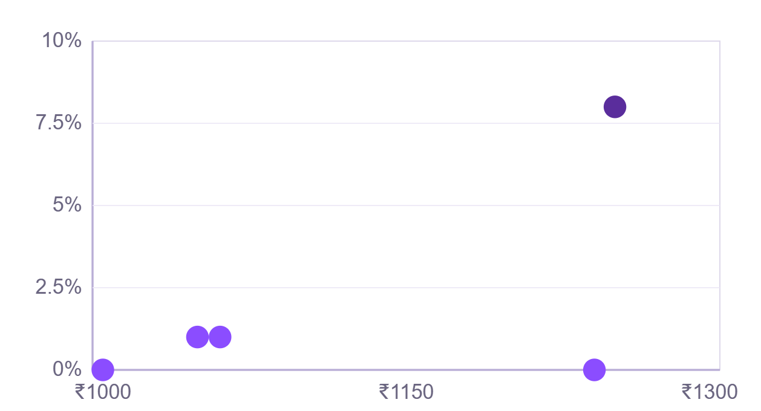
INSIGHT 4 · HIGH PRICE, SMALL DISCOUNT
Which items cost a lot but are barely discounted?
We look for products priced above ₹500 that have less than a 10% discount.
5 of the 39 shown — mostly large cooking-oil jars
SELECT DISTINCT
name, mrp, discountPercent
FROM
zepto
WHERE
mrp >
500
AND
discountPercent <
10
ORDER BY
mrp
DESC
;
MRP (₹) → · ↑ Discount %
39
products match
Insight: large cooking-oil jars dominate — premium price, very little discount.

Slide 11
INSIGHT 5 · WHO DISCOUNTS MOST
Which categories discount the most?
We group products by category and take the average discount in each, biggest first.
SELECT
category,
Fruits & Vegetables
15.46%
ROUND
(
AVG
Meats, Fish & Eggs
11.03%
(discountPercent),
2
)
Ice Cream & Desserts
AS
8.32%
avg_discount
FROM
zepto
GROUP BY
Packaged Food
8.32%
category
ORDER BY
avg_discount
Chocolates & Candies
DESC
8.32%
LIMIT
5
;
7.62%
is the catalog-wide average discount
Insight: Fruits & Vegetables discount the most at 15.46% — double the catalog average.

Slide 12
INSIGHT 6 · BEST VALUE PER GRAM
Which products give the best value for money?
A bigger pack can be cheaper per gram: ₹100 for 100 g vs ₹150 for 500 g. So we divide price by weight.
SELECT DISTINCT
Onion
₹0.02/g
name, weightInGms,
ROUND
Tata Salt
₹0.02/g
(discountedSellingPrice / weightInGms,
2
Aashirvaad Salt
₹0.02/g
)
AS
price_per_gram
Beetroot
₹0.03/g
FROM
zepto
Carrot
₹0.03/g
WHERE
weightInGms >=
Potato
₹0.03/g
100
ORDER BY
price_per_gram;
What it does: divides price by weight for each product, then sorts cheapest-per-gram first.
Insight: everyday staples and produce — onion, salt, potato — win on value per gram.

Slide 13
INSIGHT 7 · SMALL, MEDIUM OR BULK
How big are the packs on the app?
We sort every product into three simple buckets by weight: low, medium or bulk.
3,392
CASE
WHEN
weightInGms <
1000
THEN
'Low'
WHEN
weightInGms <
5000
293
THEN
46
'Medium'
ELSE
'Bulk'
Low
Medium
Bulk
END
< 1 kg
1–5 kg
≥ 5 kg
What it does: CASE WHEN sorts each product into a bucket based on its weight.
Insight: the catalog is overwhelmingly small packs — built for quick, single-trip delivery.

Slide 14
INSIGHT 8 · PHYSICAL WEIGHT
How much does the inventory weigh?
For each category we multiply weight by quantity, add it up, then convert grams to kilograms.
SELECT
Cooking Essentials
1,405 kg
category,
SUM
Munchies
1,405 kg
(weightInGms * availableQuantity)
AS
Ice Cream & Desserts
491 kg
total_weight
FROM
Packaged Food
491 kg
zepto
GROUP BY
Chocolates & Candies
491 kg
category
ORDER BY
Home & Cleaning
373 kg
total_weight
DESC
;
≈ 6
tonnes total (6,005.8 kg)
Insight: the value leaders and the weight leaders can differ — money and mass tell different stories.

Slide 15
WHAT DID WE LEARN?
Five takeaways from the data
💰
📦
🏷️
⚖️
📊
Pricing
Stock
Categories
Value
Inventory
Discounts reach 51%, but the average is only 7.6%.
453 items are out of stock (~12%).
Fruits & Veg discount most, at 15.5%.
Price-per-gram compares pack sizes fairly.
≈ ₹22.4 lakh in value, ≈ 6 tonnes in weight.

Slide 16
MY PROCESS
Seven steps from raw data to insight
1
2
3
4
5
6
7
Collect data
Check quality
Clean it
Ask business questions
Write SQL
Build metrics & charts
Explain insights
Data
→
SQL
→
Insight

Slide 17
SQL SKILLS I USED
Eight everyday SQL tools, in plain words
SELECT
WHERE
ORDER BY
LIMIT
find
filter
sort
top N
GROUP BY
SUM
AVG
CASE WHEN
compare groups
add up
average
make buckets

Slide 18
WHAT THIS DOES NOT TELL US
Honest limits — and why they matter
Based on public, scraped product / inventory data (via Kaggle) — not transactions.
We do NOT know:
✕ Real orders or actual sales
✕ Profit or margins
✕ Customer behavior
✕ Zepto's internal decisions
Estimated inventory value ≠ actual sales. It is selling price × available stock.
Naming these limits is part of responsible analysis.

Slide 19
THE MAIN IDEA
Raw Data
→
SQL
→
Useful Information
→
Business Insight
Good analytics isn't just writing queries — it's asking the right questions and explaining the answers clearly.
MOHD AHMED
Data Scientist · SQL • Data Analytics • Business Intelligence

